Slide 1

Telemedicine Based Framework for Remote Diagnosis
Final Year Project – Final Presentation
By
Talha Masood (19-CS-040)
Malik Zawar (19-CS-052)
Sufyan Ali (19-CS-104)

Slide 2
OUTLINE
01
05
INTRODUCTION
EFFECT ON SOCIETY
02
06
CORE FUNCTIONALITIES
OBJECTIVE
03
IMPLEMENTATION CHALLENGES
07
FRONT END/BACK END
04
08
TARGET AUDIENCE
WORK LOAD
Department of Computer Science
HITEC University, Taxila

Slide 3

INTRODUCTION
Connect Patient and Doctor
Doctors Availability
Book Appointments
Doctors can add patients Previous History
Provides Health Care Services
Allow Doctors to add Available Slots
Upload Test Reports
Admin can manage overall System
Department of Computer Science
HITEC University, Taxila

Slide 4
01
Specialized Doctors
Connect Patients with Specialized Doctors
02
Easy Access
Provides Easy Access to Appointments
03
Chronic Diseases
Reduce the risk of exposure to Chronic Diseases
OBJECTIVES
Remote Areas
Specialized Healthcare service to Remote Areas
04
05
Wait for Appointment
Patients do not have to wait for their appointment
06
Emergency Situation
Doctors available in Emergency Situation
07
Time and Cost
Reduced Time and Cost for Patients and Doctors

Slide 5
IMPLEMENTATION CHALLENGES
1
Telecommunication Infrastructure
2
User Experience and Interface Design
3
Multilingual and Cultural Considerations
4
Devices and Platform Compatibility
Department of Computer Science
HITEC University, Taxila
5

Slide 6
TARGET AUDIENCE
Patient in Rural and Remote Areas
Patient with Limited Mobility
Busy Professional Individuals
Patient with Chronic Disease
Mental Health Patients
7/8/2023
Department of Computer Science
HITEC University, Taxila
6

Slide 7
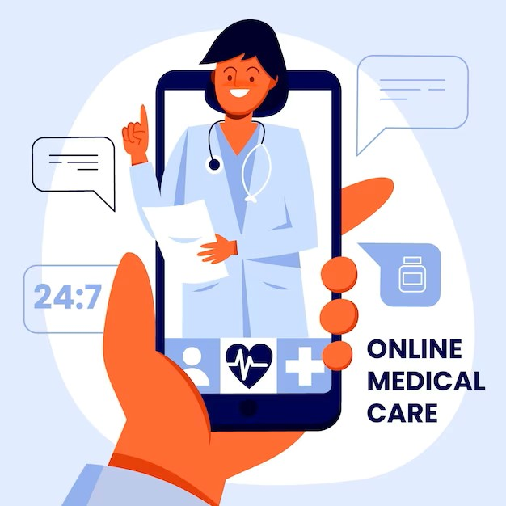
Effects on Society
Improved access to Healthcare
Increased Convenience and Flexibility
Enhance Patient Engagement and Empowerment
Reduce Strain on Healthcare System
Disaster Response and Emergency Care
Notes:
Enhanced Patient Engagement and Empowerment: Telemedicine empowers patients to take an active role in their healthcare. It enables easier access to medical information, test results, and personalized treatment plans. Patients can participate in virtual consultations, ask questions, and better understand their conditions, leading to improved engagement and adherence to treatment protocols.

Slide 8
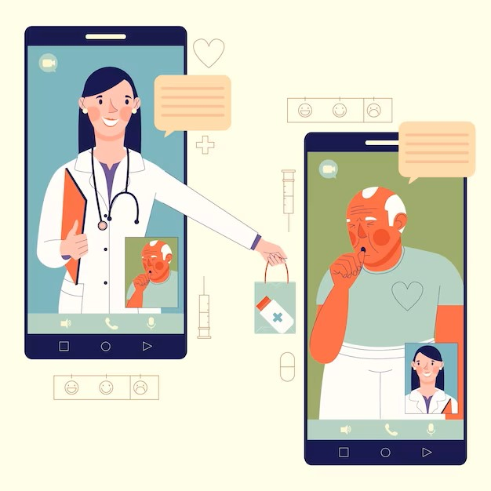
Core Functionalities
Patients Appointment with Doctor
Patients History
Reports Portal for Patients
Verification of Doctors by Admin
Appointment Scheduling by Doctor

Slide 9
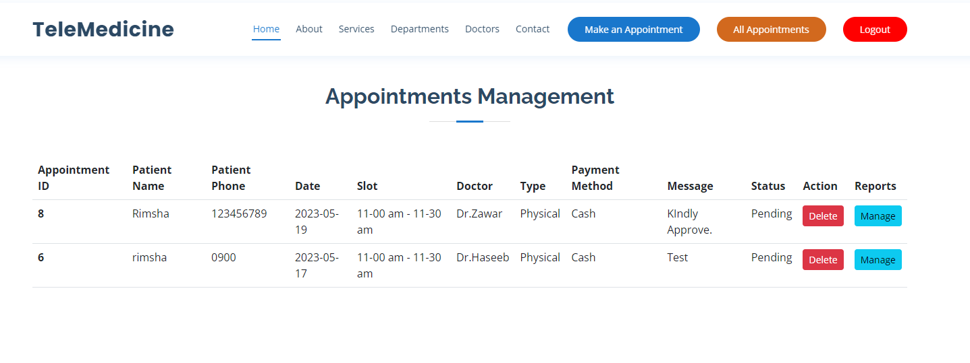
Patients Dashboard

Slide 10
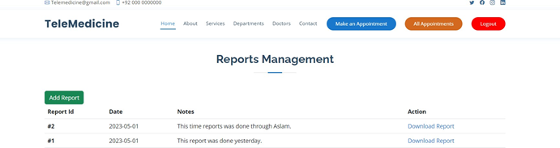
Patients Dashboard Cont.

Slide 11
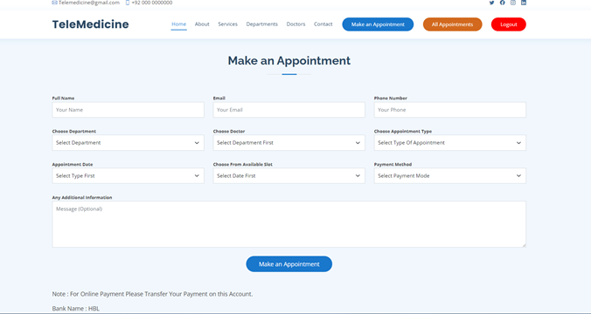
Patients Dashboard Cont.

Slide 12
Patients Dashboard Cont.
Book Online Appointment
Book Physical Appointment
Manage Reports
Check All Appointments
Selects Method of Payment

Slide 13
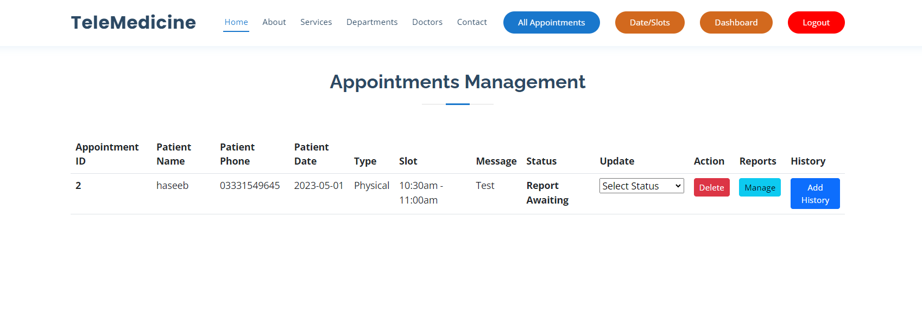
Doctors Dashboard Cont.

Slide 14
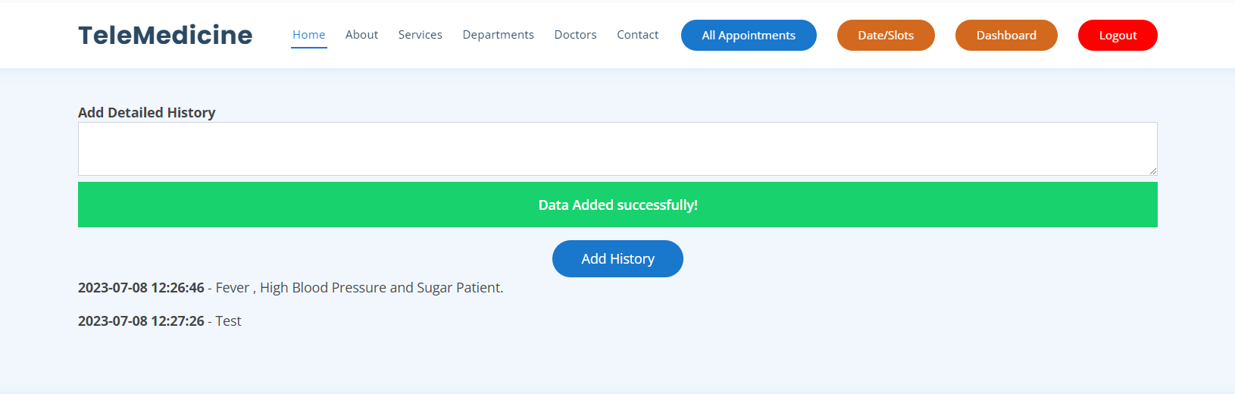
Doctors Dashboard Cont.

Slide 15
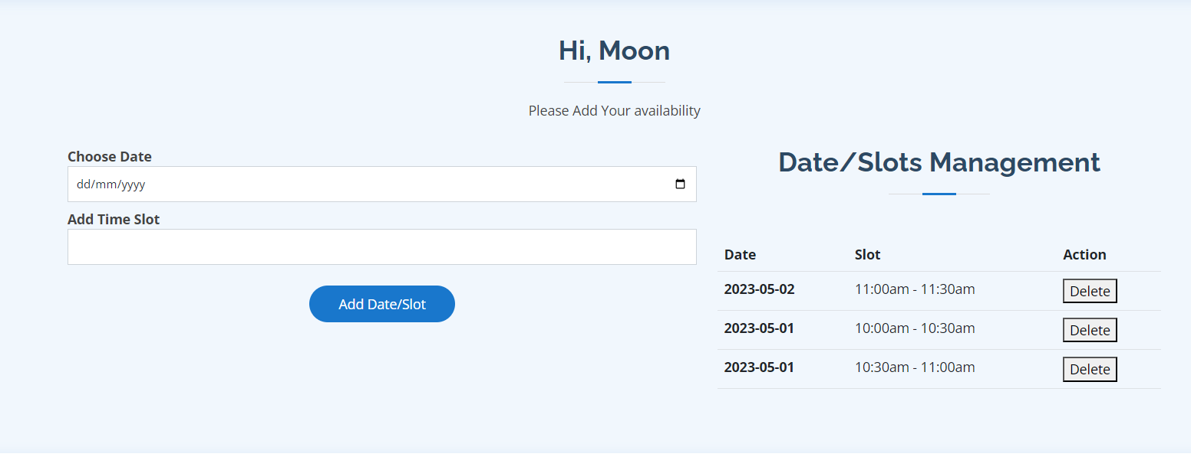
Doctors Dashboard Cont.

Slide 16
Doctors Dashboard Cont.
Manage All Appointments
Update Date and Slot for Appointment
Manage Status of Appointment
Add History of Patients

Slide 17
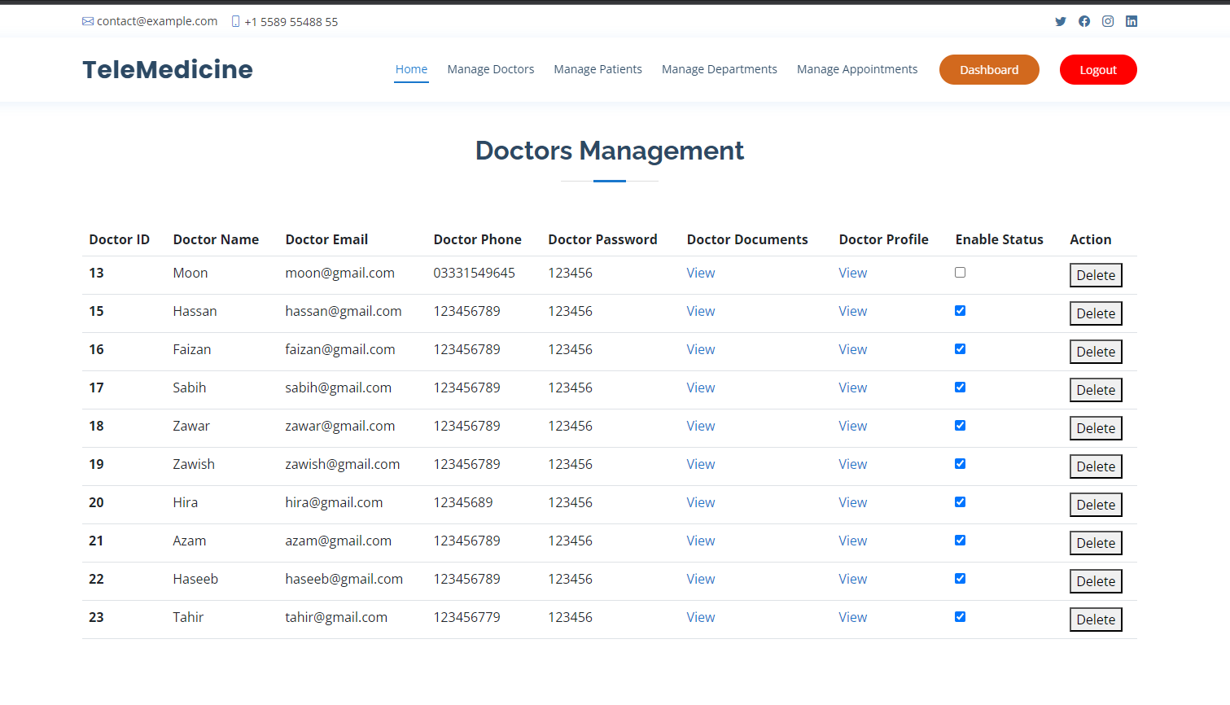
Admin Dashboard
7/8/2023

Slide 18
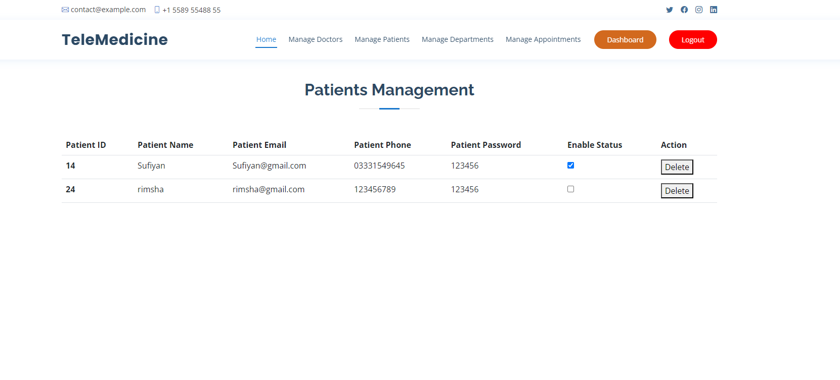
Admin Dashboard Cont.

Slide 19
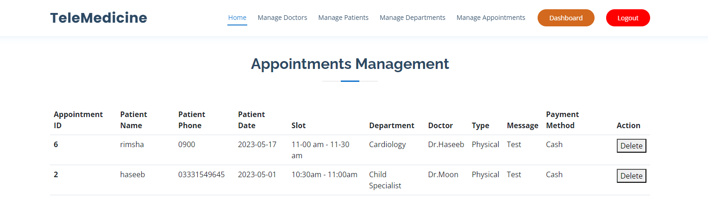
Admin Dashboard Cont.

Slide 20
Admin Dashboard
Add/Remove Doctor
Manage Patients
Manage Appointments

Slide 21
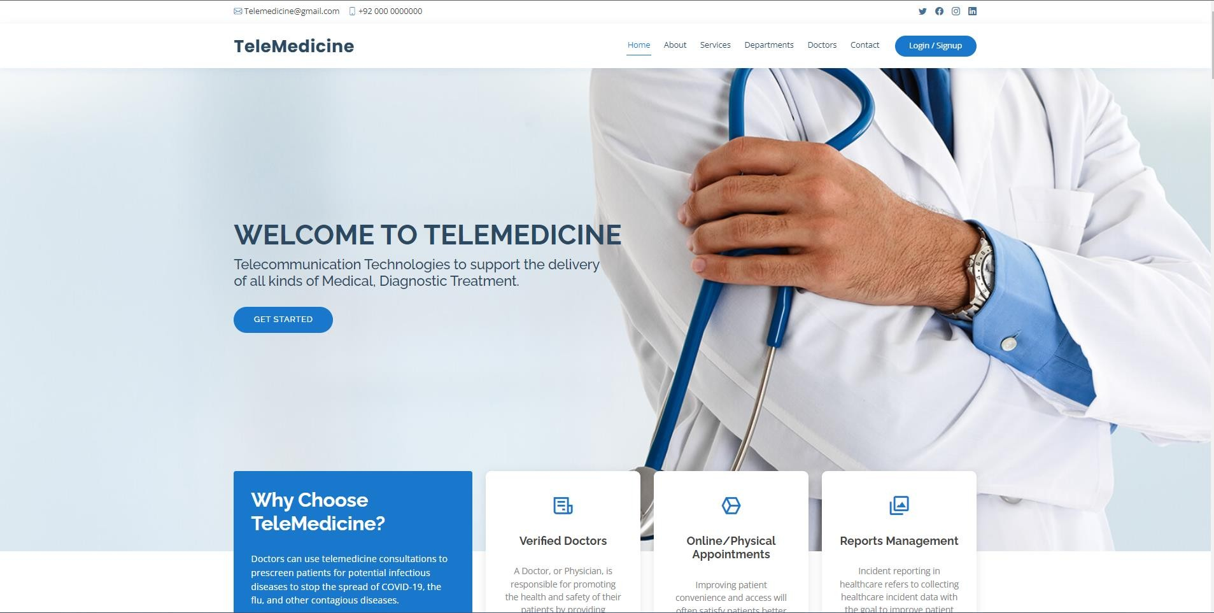
Front End of TBFRD

Slide 22
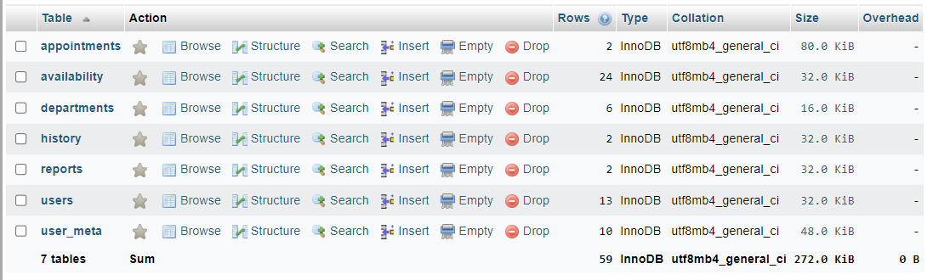
Back End of TBFRD

Slide 23
Work Load
TASKS | October | November | December | January | February | March | April | May | June
Front End
Back End
Database
Testing
Front End
Back End
Database
Testing
Malik Zawar
Talha Masood
Sufyan Ali
All of three

Slide 24
Thank You
Any Questions?
Department of Computer Science
HITEC University, Taxila

